Slide 1
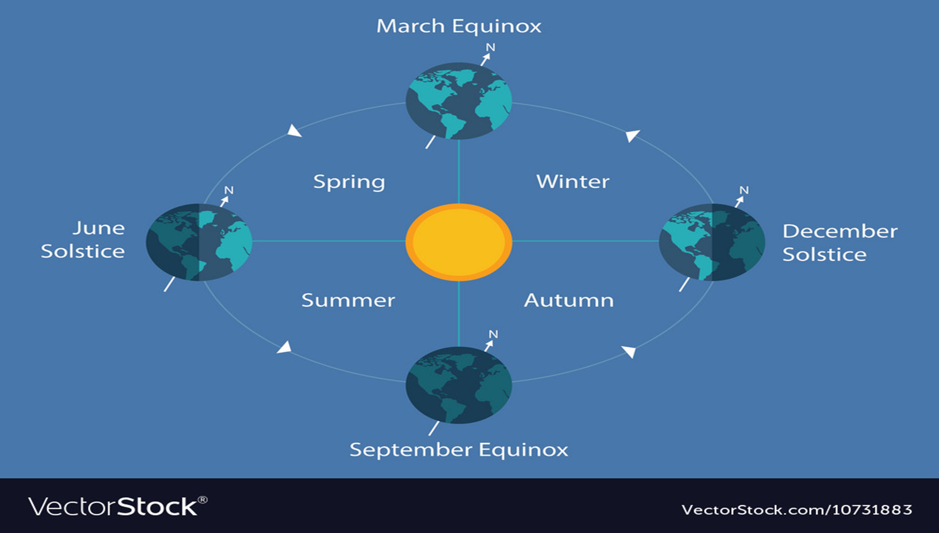
CHAPTER FIVE THE CLIMATE OF ETHIOPIA
AND
THE HORN

Slide 2
5.1 Introduction
Ethiopia is characterized by a wide variety of altitudinal ranges and diverse climatic conditions.
Because of its closeness to the equator and the Indian Ocean, the country is subjected to large temporal and spatial variations in elements of weather and climate.
The climate of Ethiopia is therefore mainly controlled by:-
1. The seasonal migration of the Intertropical Convergence Zone (ITCZ) and associated atmospheric circulations and
2. The complex topography of the country.

Slide 3
5.1 Introduction…
Weather… is the instantaneous or current state of the atmosphere composing temperature, atmospheric pressure, humidity, wind speed and direction, cloudiness and precipitation.
In general, the weather that impacts the surface of the Earth and those that live on the surface takes place in the troposphere
Climate… refers the state of the atmosphere over long time periods, decades and more. It is the composite of daily weather conditions recorded for long periods of time.

Slide 4
5.2. Elements and Controls of Weather and Climate

Slide 5
5.2.1. Controls of Weather and Climate
The climate of any particular location on earth is determined by a combination of many interacting factors. These include:-
latitude,
Elevation,
Nearby water,
Ocean currents,
Topography,
Vegetation, and
Prevailing winds.
Hotness or coldness, rainy or cloudiness, sunniness, windiness or calmness, of air you are feeling on the daily base in your current location are expressions of weather.
The question is……what determines the variations in weather and climate between places and seasons. ?
The determining factors are called “controls of weather and climate or climatic controls”.

Slide 6
a. Latitude
Latitude is the distance of a location from the equator. The sun shines directly on equator for more hours during the year than anywhere else.
Latitudinal location of Ethiopia and the Horn resulted in;
high average temperatures,
high daily and small annual ranges of temperature,
no significant variation in length of day and night between summer and winter.

Slide 7
b. Inclination of the Earth's Axis
The earth's rotation axis makes an angle of about 66 ½ ° with the plane of its orbit around the sun, or about 23 ½ ° from the perpendicular to the ecliptic plane.
This inclination determines the location of the Tropics of Cancer, Capricorn and the Arctic and Antarctic Circles.
As the earth revolves around the sun, this inclination produces:-
A change in the directness of the sun's rays;
Differences in length of day and seasons.
Astronomically, our planet’s seasons change on four particular days each year:-
Two solstices, one in June and one in December, and
Two equinoxes (one in March and one in September).

Slide 8
Equinoxes and Solstices
An equinox is the instant of time when the sun strikes the plane of the Earth's equator.
The term equinox, finds its origin in Latin with the roots aequus meaning “Equal” and nox meaning “Night.”
Astronomers define the equinox as the moment the Earth’s Equator on its axis passes the same plane of the Sun’s equator
During this passage the length of day and night are equal.
Equinox appears twice a year.
Two major equinoxes‟;
The Vernal (spring) equinox: and
The Autumn equinox:

Slide 9
Equinoxes
The Vernal (spring) equinox(march-21): is the day when the point of verticality of sun’s rays crosses the equator northwards.
This equinox experiences in Northern Hemisphere when the sun is exactly above the equator.
During this period, the length of day and night are equal.
Marks the beginning of spring season.
The Autumn equinox(September-23rd): appears to happen when the sun crosses equator giving approximately equal length between day and night.
It appears to happen when the visible sun moves south across the celestial equator on 23rd of September.
It marks the beginning of Autumn season.

Slide 10
Solstices
Solstice:- is an event when the overhead sun appears to cross northern or southern points relative to the celestial equator resulting in unequal length of days and nights in the hemispheres.
Both hemispheres during this event has either the most or least sunlight of the year.
The summer Solstice: on June 21st, the northern hemisphere has maximum tilt towards the sun experiencing longest daylight of the year.
It is the astronomical first day of summer in the Northern Hemisphere.
The sun is at its highest position in the noonday sky, directly above 23 ½ in the Tropic of Cancer.
The winter solstice: 22nd of December is the day when the maximum southward inclination is attained in the Southern Hemisphere.
In this event the sun travels shortest length causing longest night and shortest daylight.
it occurs when the sun is directly over the Tropic of Capricorn, which is located at 23 ½ ° south of the equator.

Slide 11
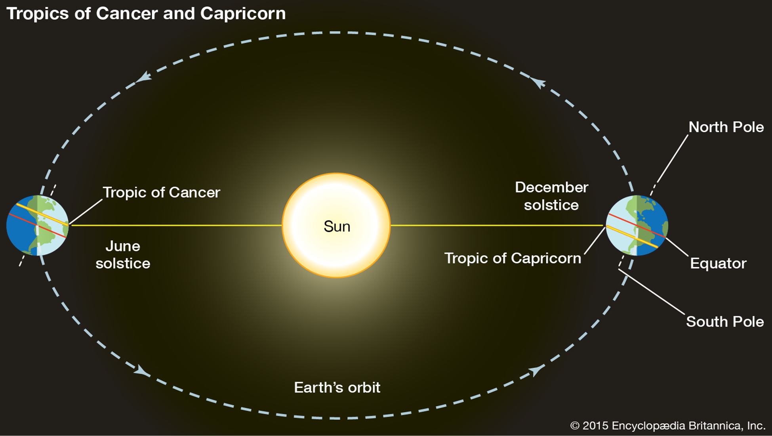
The summer Solstice(June 21st) and The winter solstice(22nd of Dec)

Slide 12
Equinox and Solstice

Slide 14
c. Altitude
Altitude is the height of location above the sea level.
Under normal conditions there is a general decrease in temperature with increasing elevation.
The average rate at which temperature changes per unit of altitudinal change is known as lapse rate.
is limited to the lower layer of the atmosphere named as troposphere.
The normal lapse rate is 6.5°C per kilometer rise in altitude.

Slide 15
Why temperature decrease as we go up?
1. As elevation increases, pressure falls….since they are directly proportional, the fall on pressure will result in temperature decrease
2. With increase in elevation, the concentration of GHG(water vapor, carbon dioxide) decrease, hence heat observation capacity of the atmosphere will decrease

Slide 16
Types of lapse rate
Three types of lapse rates are identified;
Dry adiabatic laps rate
Wet Adiabatic laps rate
Environmental lapse rate or Atmospheric lapse late

Slide 17
Adiabatic laps rate
An adiabatic lapse rate
is the rate at which the temperature of an air parcel changes in response to the expansion or compression process associated with a change in altitude.
Vertical displacements of air are the major cause of adiabatic temperature changes.
When air rises, it expands because there is less weight of air upon it.
As long as the air in the parcel is unsaturated (the relative humidity is less than 100%), the rate of adiabatic cooling or warming remains constant.

Slide 18
i. Dry adiabatic laps rate
is the rate an unsaturated parcel of air warms or cools when moving vertically through the atmosphere
if the upward movement of air does not produce condensation, then the energy expended by expansion will cause the temperature of the mass to fall at the constant dry adiabatic lapse rate.
The adiabatic lapse rate for a dry atmosphere, which may contain water vapor but which has no liquid moisture present in the form of fog, droplets, or clouds.
The rate of heating or cooling is about 10°C for every 1000 m of change in elevation.
This rate applies only to unsaturated air, and thus it is called the dry adiabatic laps rate.

Slide 19
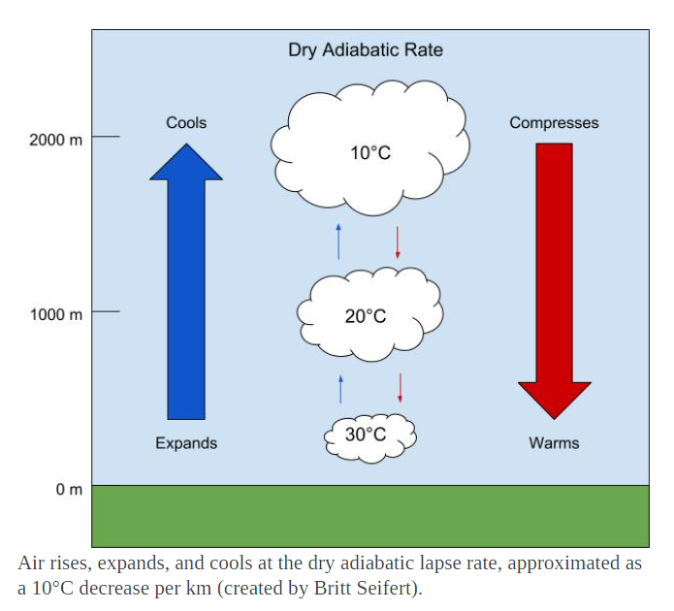
This drop in temperature is due to adiabatic expansion and a decrease in internal energy.

Slide 20
ii. Wet Adiabatic laps rate
is the rate at which a saturated parcel of air warms or cools when it moves vertically.
Due to the fact that the heat added during condensation starts cooling following the expansion, the air will no longer cool at the dry adiabatic rate.
This is due to the latent heat in the water vapor carried by the air.
The heat is released in the process of ascent, therefore affecting or lowering the rate of temperature change of the rising air.
If a saturated air containing water droplets were to sink, it would compress and warm at the moist adiabatic rate because evaporation of the liquid droplets would start the rate of compressional warming.

Slide 21
ii. Wet Adiabatic laps rate…
Prolonged cooling of air invariably produces condensation, thereby liberating latent heat.
Therefore, rising and saturated or precipitating air cools at a slower rate than air that is unsaturated.
This process is called wet adiabatic temperature change. The rate of cooling of wet air is approximately 50c per 1000 meters ascend.

Slide 22
iii. Environmental lapse rate or Atmospheric lapse late
This refers to the actual, observed change of temperature with altitude.
Temperature is normally highest at low elevations and decreases with altitude
This indicates that most of the atmospheric heat is received directly from the earth's surface and only indirectly from the sun.
The lower layer is warmer, because
it is closest to the direct source of heat
high density of heat.
It contains more water vapor and dust, which causes it to be a more efficient absorber of earth radiation than is the thinner, drier, cleaner air aloft.
This decrease in temperature upward from the earth's surface normally prevails throughout the lower atmosphere called troposphere.
The rate of change is 6.50C/1000 meters.

Slide 23
5.3. Spatiotemporal Patterns and Distribution of Temperature and Rainfall in Ethiopia
5.3.1. Spatiotemporal Distribution of Temperature
is primarily determined by altitude and latitude.
The location of Ethiopia at close proximity to equator, a zone of maximum insolation, resulted for every part of the country to experience overhead sun twice a year.
However, in Ethiopia, as it is a highland country, tropical temperature conditions have no full spatial coverage. They are limited to the lowlands in the peripheries.
Temperature, as it is affected by altitude, decreases towards the interior highlands.
Mean annual temperature varies from over 30 0C in the tropical lowlands to less than 100c at very high altitudes.

Slide 24
5.3.1. Spatiotemporal Distribution of Temperature…
The Bale Mountains are among highlands where lowest mean annual temperatures are recorded.
The highest mean maximum temperature in the country is recorded in the Afar Depression.
Moreover, lowlands of:-
North-western,
Western and
south-eastern Ethiopian experiences mean maximum temperatures of more than 30 °C.

Slide 25
5.3.1. Spatiotemporal Distribution of Temperature…
Environmental influences have their own traditional expressions in Ethiopia and there are local terms denoting temperature zones as shown in the table below:

Slide 26
Cont.…
The major controls determining its distributions are latitude and cloud cover.
In the tropics, the daily range of temperature is higher and the annual range is small, whereas the reverse is true in the temperate latitudes.
Ethiopia's daily temperatures are more extreme than its annual averages.
Daily maximum temperature varies from a high of more than 37 °C over the lowlands in northeast and southeast to a low of about 10 °C -15 °C over the northwestern and southwestern highlands.
Temperature is high during the daytime in some places, and is considerably reduced at night resulting maximum difference in the daily range.

Slide 27
Cont.…
…. in the case of monthly averages, variation is minimal and the annual range of temperature is small. This holds true in both the highlands and lowlands.
In Ethiopia and elsewhere in the Horn, temperature shows seasonal variations. For example, months from March to June in Ethiopia have records of highest temperatures.
Conversely, low temperatures are recorded from November to February.
Concerning seasonality …., there is a slight temperature increase in summer.
Southern part of Ethiopia receives highest records of temperature in autumn and spring following the relative shift of the sun; whereas in the northern part of the country, summer season is characterized by higher temperature.

Slide 28
Important pointes to bear in Mind…
Temperature and the amount of energy reaching the surface is directly related with the directness of the sun.
The direction of rain bearing winds (leeward or windward side) also determines the temperature variations in mountainous regions.

Slide 29
5.3.2. Spatiotemporal Distribution of Rainfall
The rainfall system in Ethiopia is characterized by spatial and temporal variabilities.
It needs an understanding of the position of Inter Tropical Convergence Zone (ITCZ), pressure cells, and Trade Winds.
ITCZ:-The convergence of Northeast Trade winds and the Equatorial Westerlies forms the ITCZ, which is a low-pressure zone.
Following the position of the overhead sun, the ITCZ shifts north and south of the equator.
As the shift takes place, equatorial westerlies from the south and southwest invade most parts of Ethiopia bringing moist winds.

Slide 30
5.3.2. Spatiotemporal Distribution of Rainfall ….
The ITCZ shifts towards south of equator (Tropic of Capricorn) in January.
During this period, the Northeast Trade Winds carrying non-moisture-laden dominates the region.
Afar and parts of Eritrean coastal areas experience rainfall in this period.
Following the directness of the Sun in March and September around the equator, the ITCZ shifts towards equator.
During this time, the central highlands, southeastern highlands and lowlands receives rainfall as the south easterlies bring moist winds.

Slide 31
Seasonal or Temporal Variabilities
i. Summer (June, July, August)
The sun overheads north of the equator.
From mid-June to mid-September, majority of Ethiopian regions receive rainfall , except lowlands in Afar and Southeast.
During this season, Ethiopia and the Horn come under the influence of the Equatorial Westerlies (Guinea monsoon) and Easterlies.
Hence, the Guinea monsoon and the South easterly winds are responsible for the rain in this season.

Slide 32
ii. Autumn (September, October and November)
is the season of the year between summer and winter.
In autumn the ITCZ shifts towards the equator weakening the equatorial westerlies.
During this season, the south easterlies from Indian Ocean showers the lowlands in southeastern part of Ethiopia.

Slide 33
iii. Winter (December, January and February)
The overhead sun is far south of equator.
The northeasterly winds crossing the Red Sea carry very little moisture and supplies rain only to the Afar lowlands and the Red Sea coastal areas.
iv. Spring (March, April and May)
In this season, the noonday sun is shining directly on the equator while shifting north from south.(..results in longer days and more direct solar radiation providing warmer weather for the northern world.
The southeasterlies from the Indian Ocean provide rain to the highlands of Somalia, and to the central and southeastern lowlands and highlands of Ethiopia.

Slide 34
Rainfall Regions of Ethiopia
Based on rainfall distribution, both in space and time, four rainfall regions can be identified in Ethiopia and the Horn. These are:-
Summer rainfall region
All year-round rainfall region
Autumn and Spring rainfall regions
Winter rainfall region

Slide 35
i. Summer rainfall region
…all parts of the country, except the southeastern and northeastern lowlands.
The region is divided in to dry and wet summer rainfall regions.
..the wet corresponds to the area having rainfall of 1,000 mm or more.
The High altitudes and the windward side experience such rainfall amount.
ii. All year-round rainfall region
It is a rainfall region in the southwestern part of the country.
The wetness of this region is particularly due to the prepotency of moist air currents of equatorial Westerlies called the Guinea Monsoons.
Both duration and amount of rainfall decreases as we move from southwest to north and eastwards.
Months in summer gain highest rainfall whereas the winter months receive the reduced amount.
The average rainfall in the region varies from 1,400 to over 2,200 mm/year.

Slide 36
iii. Autumn and Spring rainfall regions
South eastern lowlands of Ethiopia receive rain
The south-easterlies bring rainfall from the Indian Ocean.
About 60% of the rain is in autumn and 40% in spring.
The average rainfall varies from less than 500 to 1,000 mm.
iv. Winter rainfall region
This rainfall region receives rain from the northeasterly winds. During the winter season, the Red sea escarpments and some parts of the Afar region receive their main rain.

Slide 37
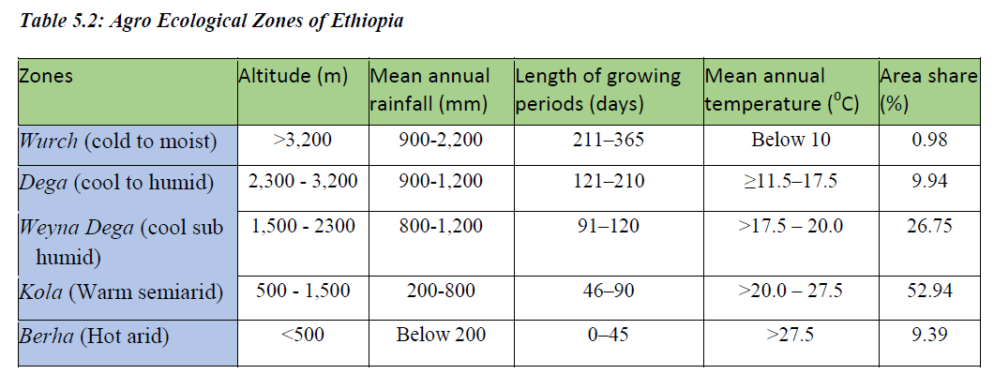
5.4 Agro-ecological Zones of Ethiopia
Ethiopia possesses diverse agro-climatic zones. These zones have traditionally been defined in terms of temperature. This system divides the nation into five major climatic zones namely Bereha, Kolla, Woina Dega, Dega and Wurch.

Slide 38
5.4 Agro-ecological Zones of Ethiopia…
The Wurch Zone :-Mountains having typically fitting characteristics of this zone include mountain systems of Ras Dashen, Guna, Megezez in North Shoa, Batu, Choke, Abune Yoseph etc.
Dega Zone:- In Ethiopia, the Dega-zone is long inhabited and has dense human settlement due to reliable rainfall for agriculture and absence of vector-borne diseases such as malaria.
Weyna Dega Zone :-It is the second largest zone covering more than 26% of the landmass of Ethiopia. The temperature and rainfall of this category is highly suitable for majority of crops grown in Ethiopia. Hence, the zone includes most of the agricultural land.
Kolla Zone :-Annual rainfall can be as high as 1,500 mm in the wet western lowlands of Gambella.

Slide 39
5.4 Agro-ecological Zones of Ethiopia…
Bereha Zone :-Strong wind, high temperature, low relative humidity, and little cloud cover usually characterize Bereha.
Evapotranspiration is always in excess of rainfall.
Djibouti, majority of Somalia, and coastal areas of Eritrea are categorized under Kolla and Bereha zones.

Slide 40
5.5. Climate Change/Global Warming: Causes, Consequences and Response Mechanisms
It refers to any change in climate over time, due to either natural variability or human activities.
5.5.1. Current Trends of Climate in Ethiopia
Ethiopia ranked 5th out of 184 countries in terms of its risk of drought.
12 extreme drought events were recorded between 1900 and 2010.
7 of the drought events occurred since 1980.
The majority of these resulted in famines.
The severe drought of 2015-2016 was exacerbated by the strongest El Nino that caused successive harvest failures and widespread livestock deaths in some regions.

Slide 41
Trends in Temperature Variability
Mean annual temperature has shown 0.2°C to 0.28°C rise per decade over the last 40-50 years.
A rise in average temperature of about 1.3°C has been observed between 1960 and 2006.
Higher rise in temperature was noted in drier areas in northeast and southeast part of the country. Notably the variability is higher in July-September.
The number of “hot days” and “hot nights” has also shown increment. Consequently, the country's minimum temperature has increased with 0.37°C to 0.4°C per decade.

Slide 42
Trends in Rainfall Variability
Precipitation has remained fairly stable over the last 50 years when averaged over the country.
Rainfall variability is increasing (and predictability is decreasing) in many parts of the country.
In some regions, total average rainfall is showing decline.
For instance, parts of southern, south-western and south-eastern regions receiving Spring and Summer rainfall have shown decline by 15-20% between 1975 and 2010.
Changes in temperature and rainfall increase the frequency and severity of extreme events.

Slide 43
5.5.2. Causes of Climate Change
Generally categorized as anthropogenic/manmade and natural causes.
A. Natural Causes :-
Earth orbital changes: The earth is tilted at an angle of 23.5° to the perpendicular plane of its orbital path.
More tilt means warmer summers and colder winters.
Energy Budget: Although the Sun's energy output appears constant, small changes over an extended period of time can lead to climate changes. Since the Sun was born, 4.5 billion years ago, the star has been very gradually increasing its amount of radiation so that it is now 20% to 30% more intense than it was once.
Volcanic eruptions: volcanic eruption releases large volumes of Sulphur dioxide, carbon dioxide, water vapor, dust, and ash into the atmosphere. The release of large volume of gases and ash can increase planetary reflectivity causing atmospheric cooling.

Slide 44
B. Anthropogenic Causes
The industrial activities that our modern civilization depends upon have raised atmospheric carbon dioxide levels from 280 parts per million to 400 parts per million in the last 150 years.
Human induced greenhouse gases such as carbon dioxide, methane and nitrous oxide have caused much of the observed increase in Earth's temperatures over the past 50 years.
Activities contributing for the concentrations of greenhouse gases:-
The decomposition of wastes in landfills,
Agriculture, ruminant digestion and manure management,
Synthetic compounds manufacturing,
Clearing of land for agriculture,
Industrial activities, and other human activities
The major gases that contribute to the greenhouse effect include Water vapor, Carbon dioxide (CO2), Methane, Nitrous oxide, Chlorofluorocarbons (CFCs).Although methane is less abundant in atmosphere, it is by far more active greenhouse gas than carbon dioxide.

Slide 45
5.5.3. Consequences of Climate Change
Impacts on human health:
Increased heat related mortality
Greater frequency of infectious disease epidemics following floods and storms, and
Substantial health effects following population displacement to escape extreme weather events. Climate change also raises the incidence malaria.
Impact on water resources:
Is leading to melting of snow and glaciers that increases rise in sea level,
Increase drought and floods,
Distorts wind flow pattern,
Decreases water table.
Impact on Agriculture:
Affect agricultural production.
Increases physiological stress and fodder quality and availability.
Impact on Ecosystem:
affects the success of species, population, and community adaptation. The rate of climatic warming may exceed the rate of shifts in certain range species, these species could be seriously affected or even disappear because they are unable to resist.

Slide 46
5.5.4. Climate Response Mechanisms
There are three major response mechanisms to climate change namely
Mitigation,
Adaptation and
Resilience.
Mitigation and its Strategies
actions that are taken to reduce and control greenhouse gas emissions changing the climate.
it implies reducing the flow of heat trapping greenhouse gases into the atmosphere, either by reducing sources of these gases or enhancing the “sinks” that accumulate and store these gases(such as the oceans, forests and soil)
The goal of mitigations is to avoid significant human interference with the climate system.

Slide 47
Mitigation and its Strategies…
There are some mitigation measures that can be taken to avoid the increase of pollutant emissions.
➢ Practice Energy efficiency
➢ Increase the use of renewable energy such as solar
➢ Efficient means of transport implementation: electric public transport, bicycle, shared cars etc.

Slide 48
Adaptation and its Strategies
Means,…adapting to life in a changing climate.
It involves adjusting to actual or expected future climate.
The goal is to reduce our vulnerability to the harmful effects of climate change such as extreme weather events or food insecurity.
Some of the major adaptation strategies include:
building flood defenses,
plan for heatwaves and higher temperatures,
installing water-permeable pavements to better deal with floods and storm water
improve water storage and use
landscape restoration and reforestation,
flexible and diverse cultivation to be prepared for natural catastrophes
preventive and precautionary measures (evacuation plans, health issues, etc.)

